Slide 1
WMS Navigation
WMS Guide

Slide 2
Table of Contents
Overview of WMS………………………………………………….…..3
WMS Portal …………………………………………………………….…6
  Login and Launching the WMS…………………………..6
  Main Portal Areas……………………………………………..10
  Menu Bar Navigation.……………………………………….12
  Access a Resource..…………………………………………..17
  Search Bar...……………………………………………………..20
  Toolbox Panel…………………………………………………..24
Resource.………………………………………………….………………33
  Access a Resource….…………….….……..….……..….….33
  Overview of a Resource…..……..…………………………35
  Search Criteria View…..……..……………………………...37
  Search Criteria Helpers.…..……..……………………...…39
  Auto-Fill Criteria………...…..……..……………………...…45
  Search Results View..…..……..……………………...…….61
  Hot Keys………..………..………....……………………...……63
  How to Personalize Business Views?...………...……71
  Need Help?....………...……………...……………...………..81

Slide 3
Overview of WMS
Back to the Table of Contents

Slide 4
Overview of WMS
What?
  EliteSeries Warehouse Management System (WMS) is a powerful execution system which manages the processes within the four walls of the distribution center, from the reception of products to their shipping, including all activities related to inventory management.
Why?
  To execute more efficient processes,
  To improve the speed of order fulfillment and the customer service,
  To improve the accuracy of data and real-time inventory visibility,
  To reduce overall supply chain expenses.

Slide 5
Overview of WMS
How?
  Users interact with WMS through desktop computers or mobile computers.
  Both types of user interfaces rely on hierarchical menu sets.
    Mobile computer users are able to confirm interactions with inventory directly through scanning bar codes.
    Desktop computers are generally used in system administration, order planning, cycle count planning, report generation, and paper-based list generation, used for picks, stores, and replenishments.

Slide 6
WMS Portal
Login and Launching the WMS
Back to the Table of Contents

Slide 7
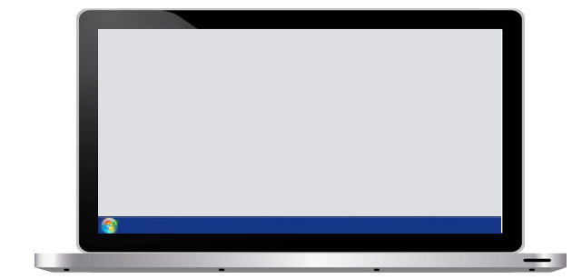
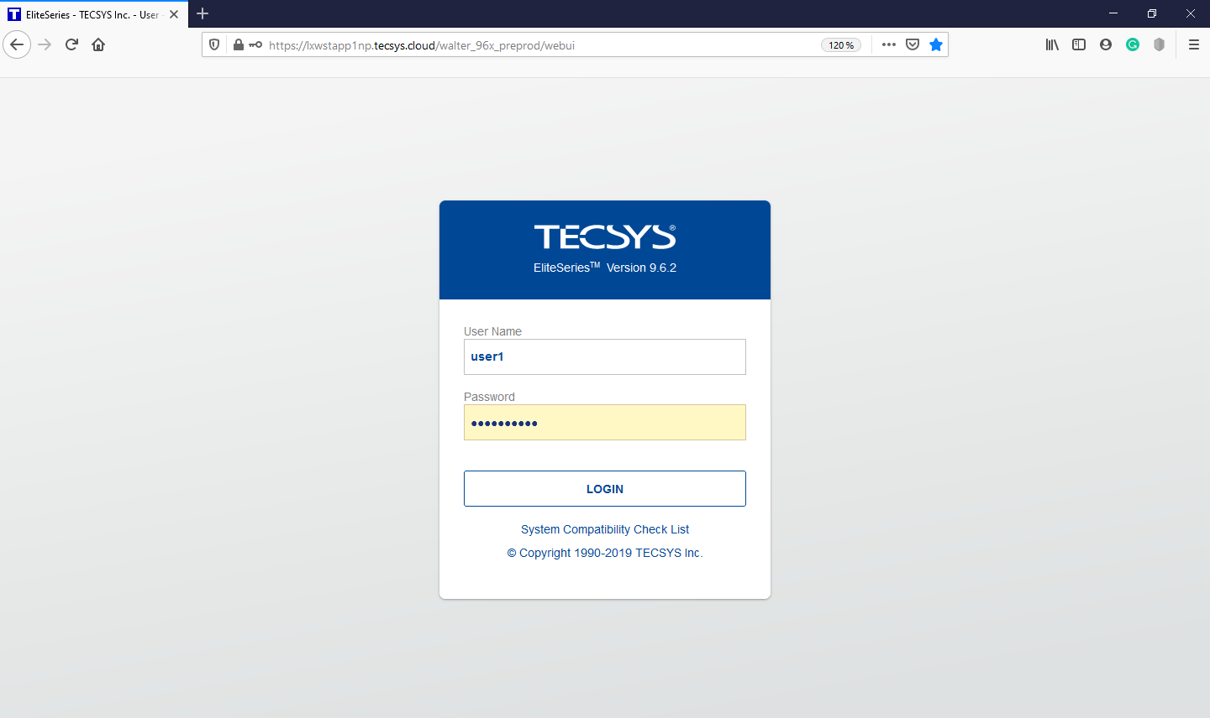
Login and Launching the WMS
Homepage Login
You must first open a Web browser window and specify the appropriate URL used to access EliteSeries WMS
In the portal login page, enter your user name as well as your password to login.
Click the Login button

Slide 8
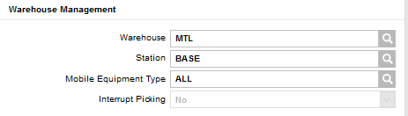
Login and Launching the WMS
Session Parameters
The Session Parameters resource displays application parameters that should be provided by the user at login time. This information is mandatory to describe the context of each application. Default values are provided.
The warehouse refers to the warehouse associated with the user. This field is displayed by default and cannot be modified.
The station is generally a central point in the facility where a user works. This field can be modified and when signing on to the system, a user must state the station from which he/she is working (e.g., Receiving dock, Picking area, Shipping dock, etc.)
The mobile equipment type refers to equipment a user actually uses on the floor, such as a cart, turret truck or a forklift. Each mobile equipment type is assigned one or more location classes, via the Mobile Equipment Details view, which define the locations the equipment type may access. This field is open and can be modified.

Slide 9
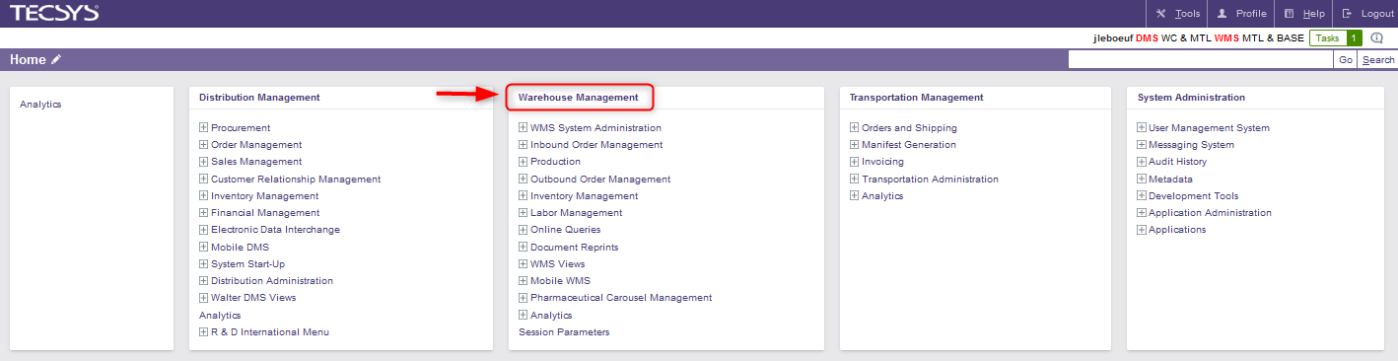
Login and Launching the WMS
Launching WMS
The EliteSeries WMS is launched from the portal as an EliteSeries portal menu.
Once logged in to the portal, click on Warehouse Management to access the main WMS menu.

Slide 10
WMS Portal
Main Portal Areas
Back to the Table of Contents

Slide 11
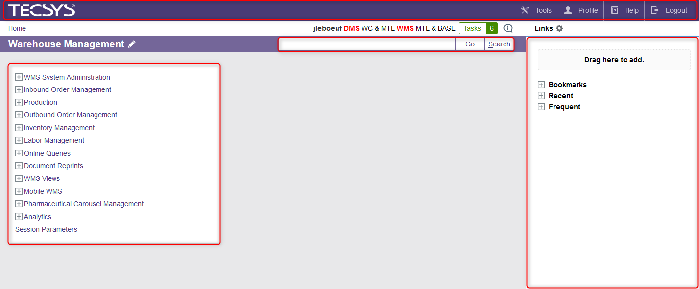
Main Portal Areas
Header Toolbar
(Parameters, Help and Logout button)
Menu Bar Navigation
Search bar
(to find a specific menu or resource)
Toolbox Panel

Slide 12
WMS Portal
Menu Bar Navigation
Back to the Table of Contents

Slide 13
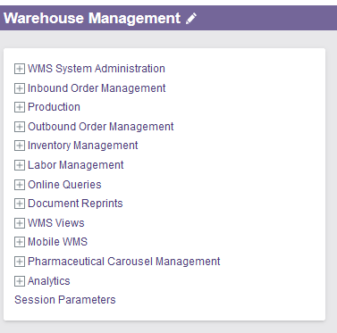
Menu Bar Navigation
Overview
The Menu Bar Navigation shows all the menus accessible in the WMS. The menu bar navigation presented below is a general one and varies according to the work performed by the user.

Slide 14
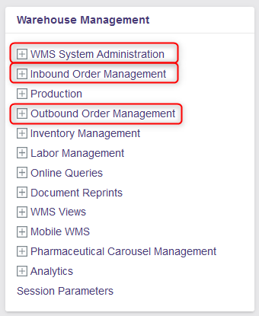
Menu Bar Navigation
Details
WMS System Administration: This menu allows the user to perform all activities related to the administration and maintenance of parameters within the WMS.
Inbound Order Management: This menu allows the user to perform all activities related to the inbound order process, such as the planning and receiving of an order as well as the customer return process and the putaway process.
Outbound Order Management: This menu allows the user to perform all activities related to the outbound order process, such as the outbound order planning and releasing as well as the picking, packing and shipping processes.

Slide 15
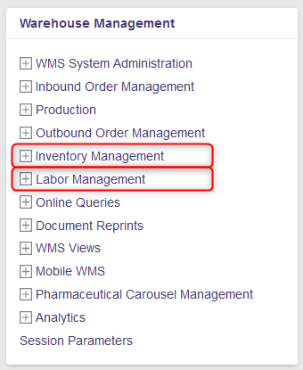
Menu Bar Navigation
Details
Inventory Management: This menu allows the user to perform activities such as the inventory relocation, inventory adjustments, inventory status modification, replenishments, cycle counts as well as activities related to maintenance of UOM and items/inventory volumetrics.
Labor Management: This menu allows the user to perform activities related to labor management. In particular, this menu includes the "Task Management" resource that is used to manage labor operations by prioritizing tasks assigned to users.

Slide 16
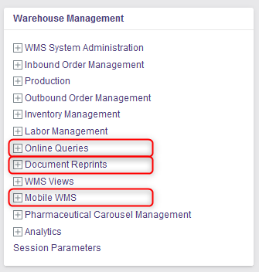
Menu Bar Navigation
Details
Online Queries: This includes a number of resources that enable you to query the database for information. Resources available in this menu include Queued Commands, shippable units to some customers, Logged Transactions, Inbound and Outbound Order Query, Shipment Completion Queues, etc.
Document Reprints: Several resources are available that allow lists, labels, and paperwork used in the warehousing process to be reprinted, such as putaway or pick list, shipping documents, etc.
Mobile WMS: This menu allows you to access to the resources available via mobile equipment (RF equipment).

Slide 17
WMS Portal
Access a Resource
Back to the Table of Contents

Slide 18
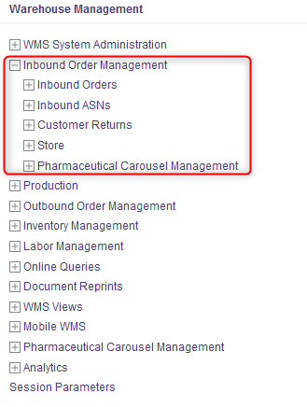
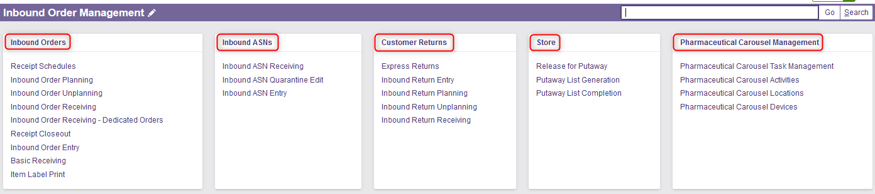
Access a Resource
By clicking on a specific menu, you can access the different resources of this menu. In this example, the "Inbound Order Management" menu allows the user to access the following resources: Inbound Orders, Inbound ASNs, Customer Returns, Store and Pharmaceutical Carousel Management.

Slide 19
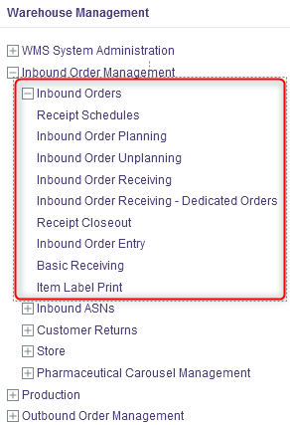
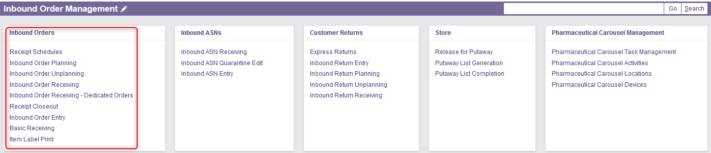
Access a Resource
Similarly, each resource consists of different sub-resources.

Slide 20
WMS Portal
Search Bar
Back to the Table of Contents

Slide 21

Search Bar
Resource Code
Each resource is associated with its own code which can be entered directly into the search bar.
Here are some examples:
Resource | Code
Inbound Order Process
Inbound Order Entry | ibom_f
Inbound Order Planning | ibom_f.plan
Inbound Order Receiving | rf_f.order_receiving
Receipt Closeout | rc_f.close
Release for Putaway | rf_f.release_putaway
Putaway List Generation | cm_f.generate_putaway
Putaway List Completion | cm_f.putaway_completion
Resource | Code
Inventory Management
Inventory Relocation | iv_f.relocation
Inventory Adjustments | iv_f.adjust
Replenishment List Completion | cm_f.replenishment_completion
Wave Replenishment Management | wv_f.repl_wave_mgmt
Cycle count Management | cc_f.mgmt
Cycle Count List Completion | cp_f.cycle_count_completion
Cycle Count Exceptions | cc_exception

Slide 22
Search Bar
Resource Code
Resource | Code
Outbound Order Process
Outbound Order Entry | om_f
Outbound Order Planning | om_f.plan
Wave Management | wv_f.wave_mgmt
Pick List Completion | cm_f.pick_completion
Basic Picking Verification | shipunit_f.basic_pick_verification
Replenishment List Completion | cm_f.replenishment_completion
Container Nest | wrk_container.nest
Container Merge or Unpack | wrk_container.merge_unpack
Shipment Edit | om_f.shipment_edit
Trailer Management | lc_f
Shipment Completion by Order | om_f.ship_complete_by_order
Shipment Completion | shipunit_f.shipment_completion
Examples (continued):

Slide 23

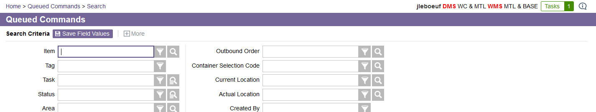

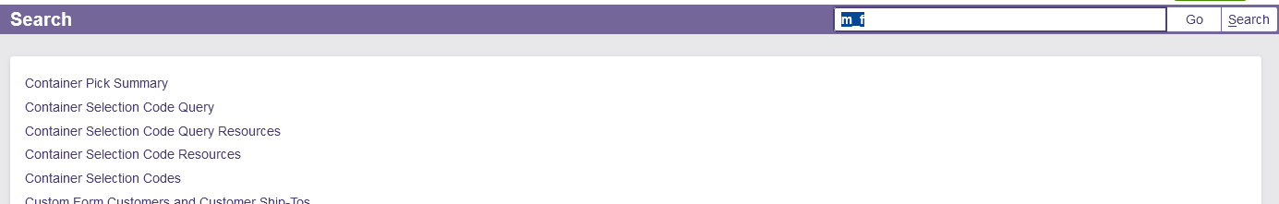
Search Bar
Go & Search
« Go »: Allows you to be redirected directly to the desired resource.
« Search »: Shows all menus or resources that contain a specific term.
You will directly access the "Queued Commands" window:
The system will show you all the menus and resources containing the “cm_f“ code:

Slide 24
WMS Portal
Toolbox Panel
Back to the Table of Contents

Slide 25
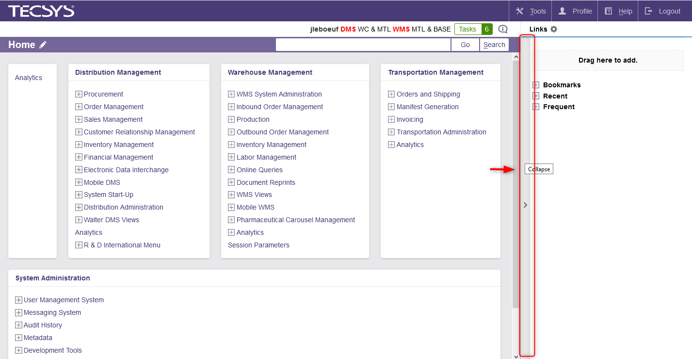
Toolbox Panel
Collapse Panel
The toolbox panel cannot be removed from the main portal. However, its display can be suppressed temporarily. To do this, move the mouse cursor to the left edge of the toolbox panel and click on the Collapse action.

Slide 26
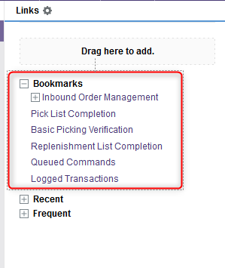
Toolbox Panel
Bookmarks
In the Toolbox Panel, you have the possibility to add menus or resources in your bookmarks if you use them often and if you want to find them more easily and quickly.
Notes:
à

Slide 27
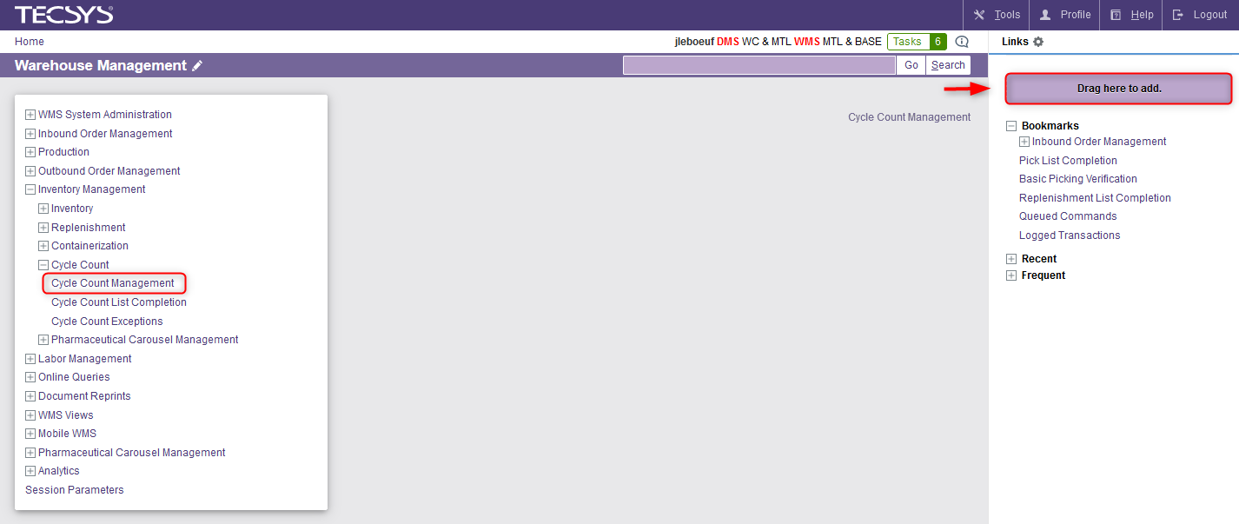

Toolbox Panel
Add a Bookmark
To add a bookmark, do this:
Show the Panel Toolbox (if it was hidden).
Drag and drop the resource you wish to add from the Menu Bar Navigation in the Toolbox Panel.
Notes:
à

Slide 28
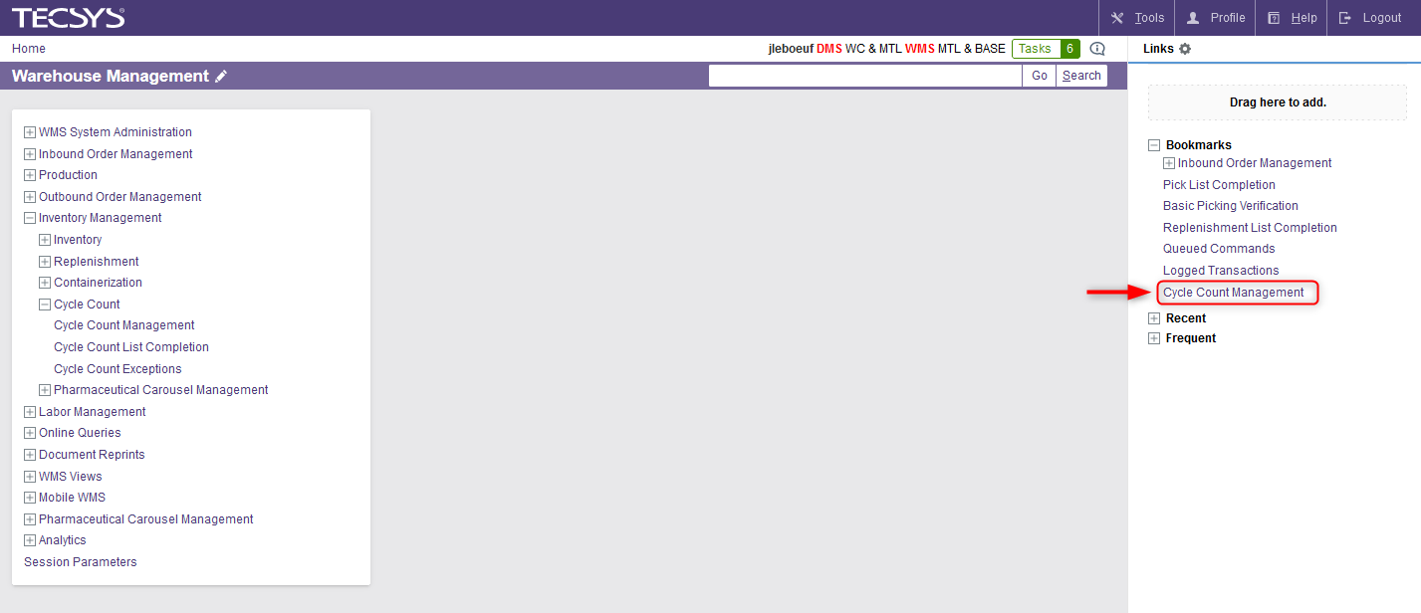
Toolbox Panel
Add a Bookmark
The resource will appear in your bookmarks:
Notes:
à

Slide 29
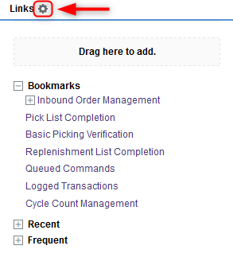
Toolbox Panel
Remove a Bookmark
To remove a bookmark:
Click on the gear at the top of the Toolbox Panel.
Notes:
à

Slide 30
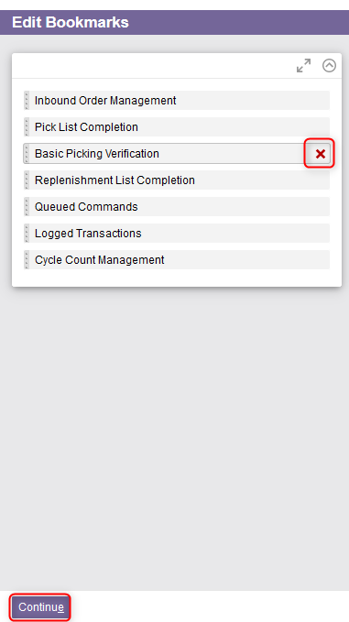
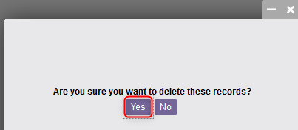
Toolbox Panel
Remove a Bookmark
Select the menu(s) and/or resource(s) you wish to remove and click the X.
A confirmation message will appear. Select Yes to confirm.
Click Continue once done.
The bookmark will be deleted.
Notes:
à

Slide 31
Toolbox Panel
Change Display Order of Bookmarks
To change the display order of bookmarks:
Click on the gear at the top of the Toolbox Panel.
Notes:
à

Slide 32
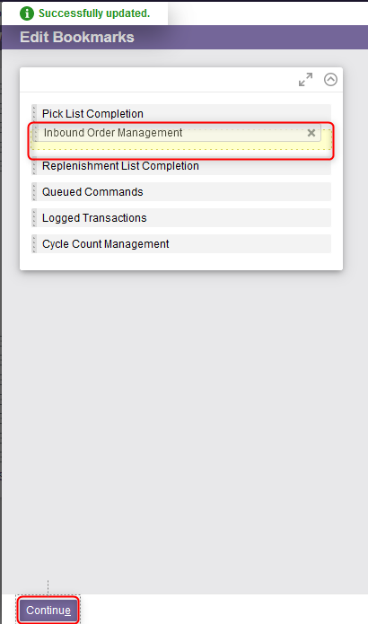

Toolbox Panel
Change Display Order of Bookmarks
Move the menus/resources in the desired order with your cursor.
Click Continue once done.
The order of the bookmarks will be changed.
Notes:
à

Slide 33
Resource
Access a Resource
Back to the Table of Contents

Slide 34
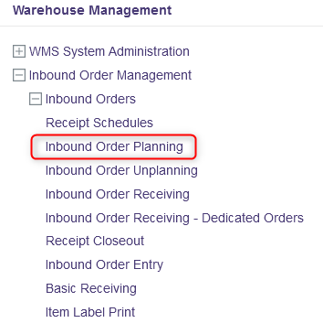


Access a Resource
As shown previously, there are two ways to access a resource: either by using the menu bar navigation or by using the search bar.
Example – Inbound Order Planning:
  Or

Slide 35
Resource
Overview of a Resource
Back to the Table of Contents

Slide 36
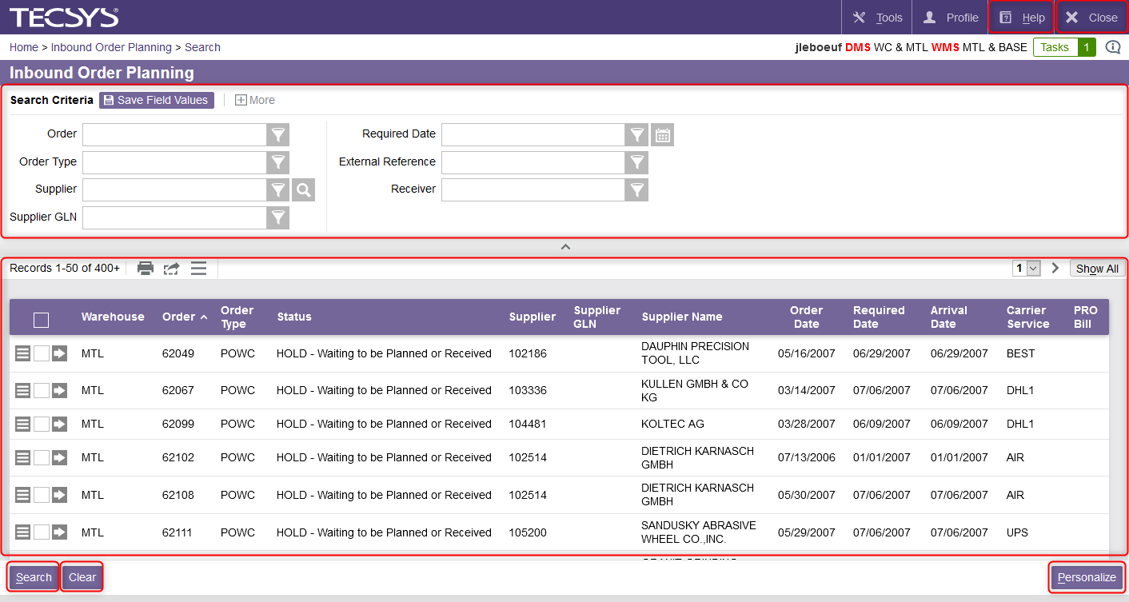
Overview of a Resource
Help button
To close the current window
Search Criteria
Allows the user to enter criteria for a given search
Search Results
Shows the results for a given search
To launch a search
Allows users to customize fields in search criteria, search results, display and other details
To clear all fields

Slide 37
Resource
Search Criteria View
Back to the Table of Contents

Slide 38
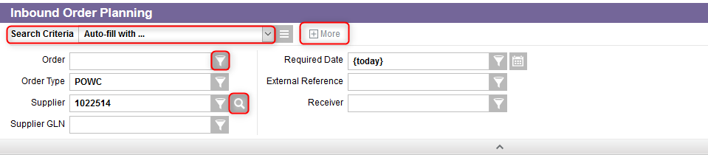
Search Criteria View
This view gives the user the current search criteria:
Auto-Fill Criteria feature
This button allows the user to show more criteria
Lookup button
This button shows criteria helpers

Slide 39
Resource
Search Criteria Helpers
Back to the Table of Contents

Slide 40
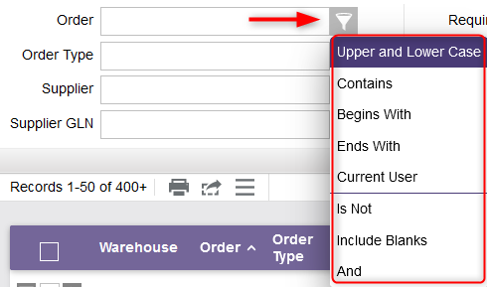
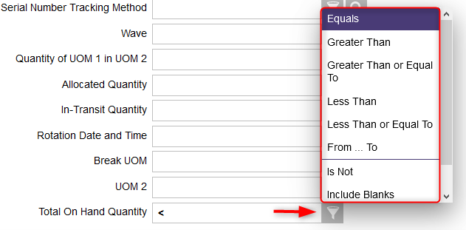
Search Criteria Helpers
The Criteria Helper functionality enables a user to produce more specific search results.
Example – Inventory Resource:
Example – Inbound Order Planning Resource:

Slide 41
Search Criteria Helpers
The following search helpers apply only to numeric fields:
Search Helper | Symbol | Description | Example
Equal | = | Finds all exact matches of the specified value.
Greater than | > | Finds all values, except for NULL values, which are GREATER THAN the specified value
Greater than or Equal To | >= | Finds all values, except for NULL values, which are GREATER THAN OR EQUAL TO the specified value.
Less than | < | Finds all values, except for NULL values, which are LESS THAN the specified value.
Less than or Equal To | <= | Finds all values, except for NULL values, which are LESS THAN OR EQUAL TO the specified value.
From … To | .. | Finds all values between, and including, the two specified values.

Slide 42




Search Criteria Helpers
The following search helpers apply only to alphanumeric/text fields:
Search Helper | Symbol | Description | Example
Upper and Lower Case | ~ | Finds all occurrences of the specified value without regard for uppercase/lowercase
Contains | ** | Finds all occurrences containing a specific value
Begins With | * | Finds all occurrences beginning with a specific value
Ends With | * | Finds all occurrences ending with a specific value

Slide 43


Search Criteria Helpers
The following search helpers apply to both text and numeric fields:
Search Helper | Symbol | Description | Example
Is Not | ! | Finds all values which are not equal to the specified value
Include Blanks | +null | Finds all values which are null. This symbol can only be used as a suffix, which means that it can only be added to the end of your search expression.
And | ; | Method to find multiples values in a search

Slide 44
Search Criteria Helpers
The following search helpers apply only to date fields:
Date used in this example: 04/23/2020
Search Helper | Symbol | The search result will show you all the values for which the date is:
Today | {today} | 04/23/2020
Tomorrow | {today + 1} | 04/24/2020
Yesterday | {today - 1} | 04/22/2020
One Week From Now | {today + 1 week} | 04/30/2020
One Week Ago | {today - 1 week} | 04/16/2020
One Month From Now | {today + 1 month} | 05/21/2020
One Month Ago | {today - 1 month} | 03/26/2020
One Year From Now | {today + 1 year} | 04/23/2021
One Year ago | {today - 1 year} | 04/23/2019

Slide 45
Resource
Auto-Fill Criteria
Back to the Table of Contents

Slide 46
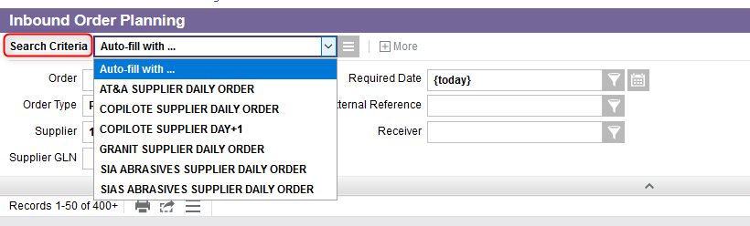
Auto-Fill Criteria
Overview
The Auto-Fill Criteria feature enables a user to save search values that come up often, in order to use them later for another search. The saved criteria values make up the criteria set, which is used to fill the search fields automatically.
Criteria sets are different field value combinations a user enters when performing a search in a regular resource or a task view.
Example – Inbound Order Planning Resource:

Slide 47
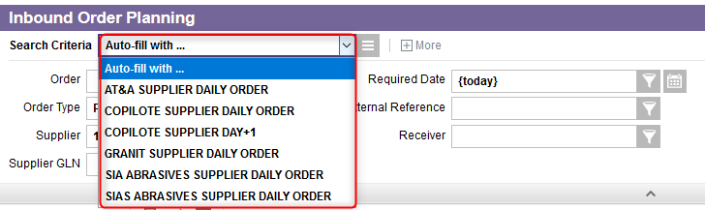
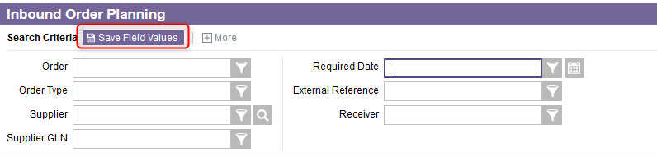
Auto-Fill Criteria
Overview
If criteria sets already exist, the Search Criteria view will appear as below:
If criteria sets do not yet exist, only the Save Fields Values button will be displayed:
You then have the option to create, save, modify, copy or delete criteria sets. This is explained in the following slides.

Slide 48
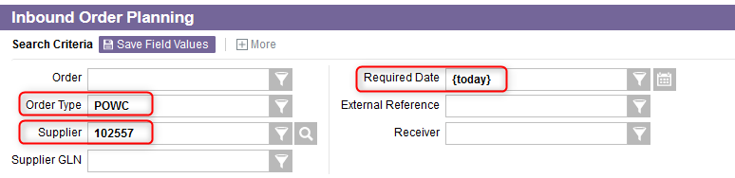
Auto-Fill Criteria
Create a Criteria Set
To create a criteria set, do this:
From the resource for which you want to create a criteria set, enter the search criteria you wish to use as your criteria set.

Slide 49
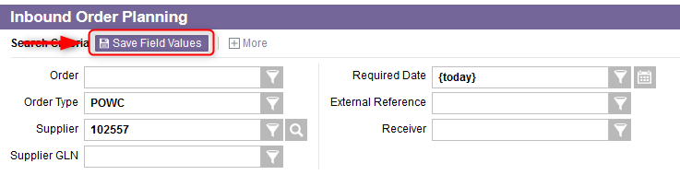
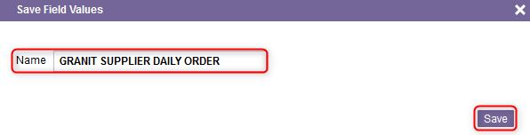
Auto-Fill Criteria
Create a Criteria Set
Select the Save Field Values action.
A pop-up window will appear. Enter the name you want to give your criteria set and click Save.

Slide 50
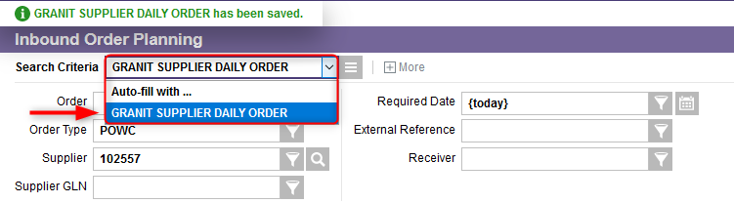
Auto-Fill Criteria
Create a Criteria Set
Once you save your criteria set, it will appear in the Auto-fill with drop-down menu as displayed below:
Note: A criteria set you created will not be available to other users.

Slide 51
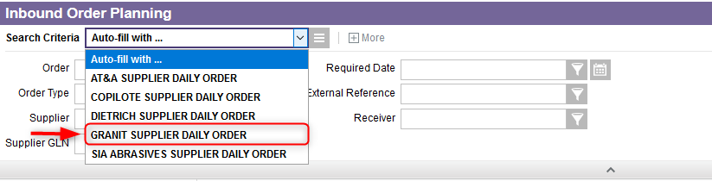
Auto-Fill Criteria
Use a Criteria Set
Once you have created and saved a criteria set, you may use it again during a later search. To use a criteria set, do this:
Launch the resource for which you have previously created a criteria set.
Select the criteria set you wish to use from the Auto-fill with drop-down menu.

Slide 52
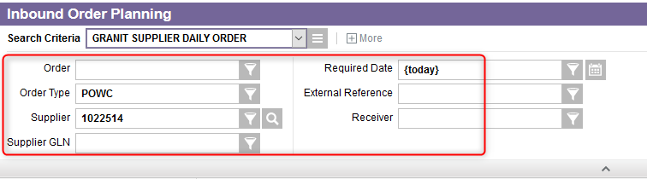
Auto-Fill Criteria
Use a Criteria Set
The search fields are automatically populated with the values you saved in your criteria set:
Note: If you define a value for a criteria field that has later been removed in the personalization of the view, the value present in the set will be ignored, as there is no criteria field to populate.

Slide 53
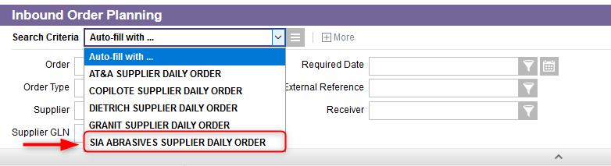
Auto-Fill Criteria
Modify a Criteria Set
You may modify existing criteria sets. To modify a criteria set, do this:
From the resource for which you want to modify the criteria set, select the criteria set from the Auto-fill with drop-down menu.

Slide 54
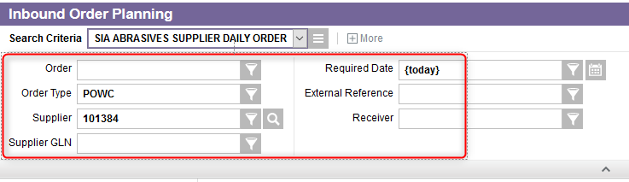
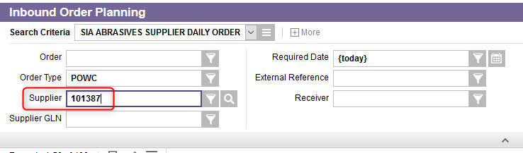
Auto-Fill Criteria
Modify a Criteria Set
The fields will be populated with your criteria set:
Modify the values in the criteria fields.

Slide 55
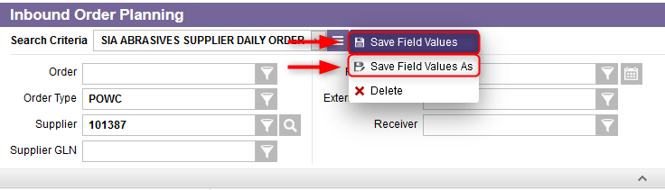
Auto-Fill Criteria
Modify a Criteria Set
Click on:
  Either the Save Field Values action to modify the criteria set,
  Or the Save Field Values As action to modify the criteria set and the name of the criteria set.
Your modifications will be saved to the criteria set you have chosen from the drop-down menu.

Slide 56
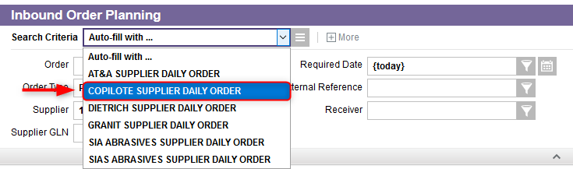
Auto-Fill Criteria
Copy a Criteria Set
You may copy a criteria set. To copy a criteria set, do this:
From the resource corresponding to the criteria set you want to copy, select the criteria set from the drop-down list.

Slide 57
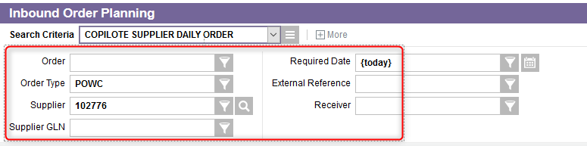
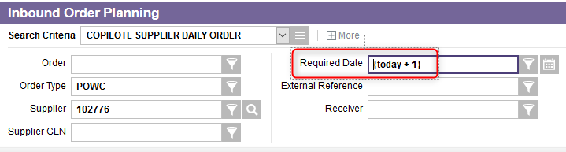
Auto-Fill Criteria
Copy a Criteria Set
The fields will be populated with the chosen criteria set:
Optionally, you may modify the values or leave them as they are.

Slide 58
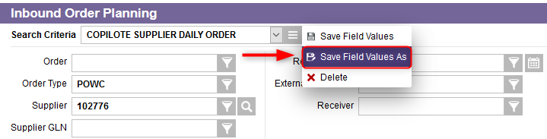
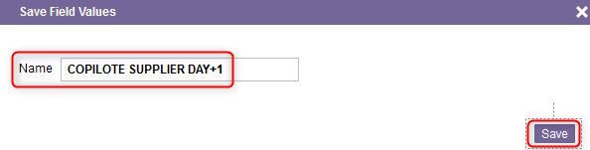
Auto-Fill Criteria
Copy a Criteria Set
Select Save Field Values As from the drop-down menu.
A pop-up window will appear. Enter the new name you want to assign to the criteria set and click Save.
The new criteria set will appear in the Auto-fill with drop-down menu.

Slide 59
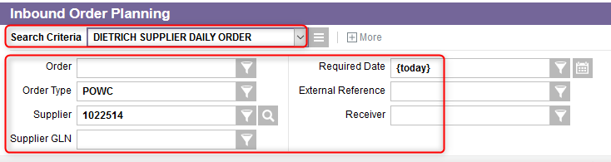
Auto-Fill Criteria
Delete a Criteria Set
You may delete a criteria set. To do this:
From the resource corresponding to the criteria set you want to delete, select the criteria set from the drop-down list.
The fields will be populated with the chosen criteria set.

Slide 60
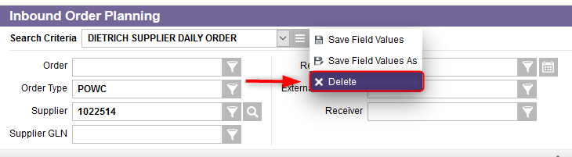

Auto-Fill Criteria
Delete a Criteria Set
Select the Delete action from the Search Criteria drop-down menu.
The criteria set will be deleted from the drop-down menu.

Slide 61
Resource
Search Results View
Back to the Table of Contents

Slide 62
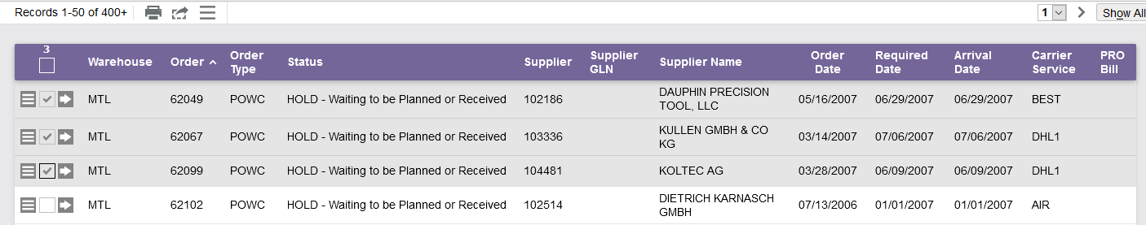
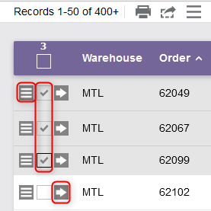
Search Results View
This view gives the user the results for a given search:
Navigate to the grid-level More Actions menu
Select one or more records of the given search
Access the view record details

Slide 63
Resource
Hot Keys
Back to the Table of Contents

Slide 64
Hot Keys
Overview
The WMS supports the use of hot key designations.
The hot keys use special keys, function keys, or keystroke combinations to accomplish common tasks without the use of a mouse.
Generally speaking, hot keys will combine the Alt or Ctrl key with another character.
Consult the tables in the next slides for a complete list of available hot key commands on both desktop computers and mobile devices.

Slide 65
Hot Keys
Application Actions
Action | Label / Icon | Hot Key (Desktop) | Hot Key (Mobile)
Close | Close, Exit | Alt+X | Ctrl+X, Alt+X
Focus on Field* | N/A | Alt+1 | Ctrl+1**, Alt+1
Help | Help | Alt+H | N/A
Logout | Logout | Alt+X | Ctrl+X, Alt+X
Tools | Tools | Alt+T | N/A
*In the handheld emulation, the Focus on Field hot key will bring the focus back to the last field on which the user had focus, if possible. Otherwise, focus will be placed on the first available field.

Slide 66
Hot Keys
Page Actions
Action | Label / Icon | Hot Key (Desktop) | Hot Key (Mobile)
Accept | Accept | N/A | Ctrl+A*, F2
Advance | Advance | Alt+9 | Ctrl+9, Alt+9
Cancel | Cancel | Alt+Z, F3 | Ctrl+B*, F3
Clear | Clear | Alt+Z | Ctrl+Z, Alt+Z
Continue | Continue | F9, Alt+E | Ctrl+E, Alt+E
Finish | Finish | F4 | Ctrl+C*, F4
Go Back | Go Back | Alt+B | Ctrl+B, Alt+B
No | No | Alt+N | Ctrl+N, Alt+N
Save | Save | Alt+S | Ctrl+S, Alt+S
Search | Search | Alt+S | Ctrl+S, Alt+S
Skip | Skip | Alt+9 | Ctrl+9**, Alt+(
Submit | Submit, OK, Done | F10, Alt+U | Ctrl+U, Alt+U
Validate* | Validate | Alt+V | N/A
Yes | Yes | Alt+Y | Ctrl+Y, Alt+Y
*The Validate action is only available for report-type resources (i.e. reports, journals, batches, and forms).

Slide 67
Hot Keys
Page-Level Edit Actions
Action | Label / Icon | Hot Key (Desktop) | Hot Key (Mobile)
Copy | Copy | Alt+C | Ctrl+C, Alt+C
Create | Create, Add | Alt+A | Ctrl+T, Alt+T
Deactivate | Deactivate | Alt+Delete | Ctrl+M, Alt+M
Delete | Delete | Alt+Delete | Ctrl+M, Alt+M
Linking | Linking | Alt+K | Ctrl+K, Alt+K
More Actions | More Actions | F1 | Ctrl+H***, Alt+H***, F1
Personalize | Personalize | Alt+P | N/A

Slide 68
Hot Keys
Search Navigation Actions
Action | Label / Icon | Hot Key (Desktop) | Hot Key (Mobile)
Navigate to the grid-level More Actions menu |  | N/A | Ctrl+R, Alt+R
Navigate to the record-level More Actions menu of the next (or first) record in search results and cycle through the remaining records on the page |  | Alt+Q | Arrow Keys
Next Page |  | Alt+Page Down | N/A
Previous Page |  | Alt+Page Up | N/A
Toggle between Show All and Show Pages | Show All, Show Pages | Alt+O | Ctrl+O, Alt+O

Slide 69
Hot Keys
Array-Level Edit Actions & Record Navigation Actions
Array-Level Edit Actions:
Action | Label / Icon | Hot Key (Desktop) | Hot Key (Mobile)
Append | Append | Alt+A | Ctrl+T, Alt+T
Delete | Delete | Alt+Delete | Ctrl+M, Alt+M
Insert | Insert | Alt+Insert | N/A
Record Navigation Actions:
Action | Label / Icon | Hot Key (Desktop) | Hot Key (Mobile)
Go to Search Page | Go to Search Page | Alt+R | Ctrl+R, Alt+R
Next Record |  | Alt+Down Arrow | Ctrl+P, Alt+P
Previous Record |  | Alt+Up Arrow | Ctrl+O, Alt+O
Previous Section Group | Previous Section Group | N/A | Ctrl+8, Alt+8

Slide 70
Hot Keys
Field-Dependent Actions*
Action | Label / Icon | Hot Key (Desktop) | Hot Key (Mobile)
Criteria Helper |  | Alt+G, Ctrl+Spacebar | N/A
Lookup |  | Alt+L | Ctrl+7**, Alt+7
Multivalue |  | Alt+L | Ctrl+7**, Alt+7
*As their action type implies, field-dependent actions will execute differently depending on which field the cursor happens to be focused on when the hot key is pressed.

Slide 71
Resource
How to Personalize Business Views?
Back to the Table of Contents

Slide 72


How to Personalize Business Views?
Personalize Search Criteria View
Once clicked on the "Personalize" button in the lower right corner, a new window will appear. The first tab is used to customize the search criteria view.
  The “Show These Fields in This Order” list box contains fields which are actually displayed in your current Search Criteria view.
  The “Available Fields” list box contains the criteria data elements that are available for the view.

Slide 73

How to Personalize Business Views?
Personalize Search Criteria View
Follow the steps below to customize your Search Criteria view:
1. Highlight one or more fields that you want to include in the criteria.
2. Press the Add action to move them to the right-hand side of the screen.
3. Move Up or Move Down action to change the order in which the fields appear on the screen.
4. To remove one or more fields, highlight the fields and click the Remove action.
5. Click the Submit action

Slide 74

How to Personalize Business Views?
Personalize Search Criteria View
In this example, the new Search Criteria “Requested Item” will be displayed:

Slide 75

How to Personalize Business Views?
Personalize Search Results View
In the same way as for the search criteria view, personalizing the results section of a given view's Search page allows you to display search results in a variety of ways. The Search Results tab enables you to configure the display and content of search results quickly and easily.
A text box that enables you to filter on the fields displayed in the Available Fields list box by entering a given string of characters.
A list box that contains the actual fields and groups of fields that will appear in the results section of the view's Search page.
A list box that contains the fields available for the view.

Slide 76

How to Personalize Business Views?
Personalize Details of a Search Result
The content of a details page can be personalized as well. To do this, access the third tab “Details”.
You will then be able to select the fields that you wish to modify by selecting the Add, Move Up and Move Down, and Remove actions.

Slide 77

How to Personalize Business Views?
Setting More Options
The last tab "Option“ includes a number of additional settings that can be defined while personalizing a view.

Slide 78
How to Personalize Business Views?
Setting More Options
The additional personalization options are briefly described below:
  Personalize View Options
    Number of Records per Page: There are different possible values which include 10, 20, 30, 50, 100, 1000 or 10 000.
    Maximum Number of Records to Retrieve: This default can be changed system-wide via the Maximum Search Result Records to Display field in the Users resource.
    Related Resource Group: Every view can be personalized to belong to a given related resource group.

Slide 79
How to Personalize Business Views?
Setting More Options
The additional personalization options are briefly described below (continued):
  BEHAVIOR
    Automatically Perform a Search When the Number of Records is Less Than: Set this value to zero to automatically perform a search when launching a view, regardless of the number of records in the database.
    Automatically Perform a Search When You Enter Criteria: The default value is No. When this option is selected, it is at the user's discretion when to perform the search. Set this value to Yes to trigger the search immediately as soon as the user tabs out from the edited criteria field.
    When a Search Finds a Single Record: The default value is Display Record in Search Results. In this case, the search results grid is shown. The user needs to navigate further to see the record details. Set this value to Display Record Details to display a record's details instead of the search results grid, when a search produces only one record.

Slide 80
How to Personalize Business Views?
Setting More Options
The additional personalization options are briefly described below (continued):
  BEHAVIOR
    Record Creation: This provides the ability to render a view in such a way that adding a record can be done in a single step, rather than two. If the view in question is a transactional child view, Record Creation is always set to Enter Key and Save. This setting has the following options:
      Enter Key and Go to Main Details, where the record is created in two steps;
      Enter Key and Save, where the record is created in a single step; and,
      Enter Key, Save and Go to Main Details, where the record is created in a single step and remains in modification mode.

Slide 81
Resource
Need Help?
Back to the Table of Contents

Slide 82

Need Help?
If you need help at any time, a button for help is available in the upper right corner of the Header Toolbar.
There are three types of help available:
A new window will appear showing all the help content proposed regarding the management of WMS in general.
The new window will help you with the current menu.
The new window will show you the search tips, such as Criteria Helper and Search Operators.

